Slide 1
CSE-207
Lecture 5
Minimum spanning trees

Slide 2
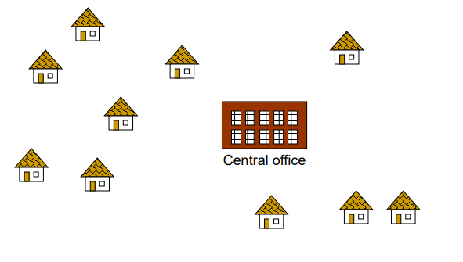
Problem: Laying Telephone Wire

Slide 3
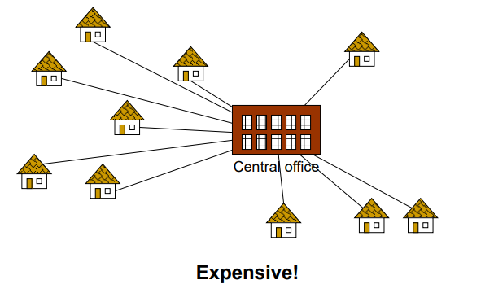
Wiring: Naïve Approach

Slide 4
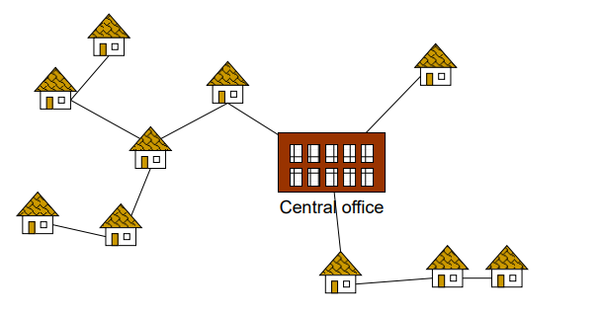
Wiring: Better Approach

Slide 5
Spanning Tree
A minimum spanning tree (MTS) is a subgraph of an undirected graph such that the subgraph spans (include) all node is connected , is acyclic And has minimum total edge weight.
A spanning tree of G is a subgraph T that is:
・Connected.
・Acyclic.
・Includes all of the vertices.
Graph-G
1
1
6
5
1
1
2
5
5
4
2
5
4
3
3
3
4
2
3
4
2
5
6
6
5
6

Slide 6
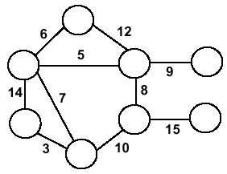
Minimum Spanning Trees
Undirected, connected graph G = (V,E)
Weight function W: E → R (assigning cost or length or other values to edges)
Spanning tree: tree that connects all the vertices (above?)
Minimum spanning tree: tree that connects all the vertices and minimizes

Slide 7
Minimum Spanning Tree (MST)
A minimum spanning tree is a subgraph of an undirected weighted graph G, such that
it is a tree (i.e., it is acyclic)
it covers all the vertices V
contains |V| - 1 edges
the total cost associated with tree edges is the minimum among all possible spanning trees
not necessarily unique

Slide 8
How Can We Generate a MST?
9
b
9
b
a
2
6
a
2
6
d
d
4
5
4
5
5
4
5
4
5
e
5
e
c
c

Slide 9
Greedy Choice
We will show two ways to build a minimum spanning tree.
A MST can be grown from the current spanning tree by adding the nearest vertex and the edge connecting the nearest vertex to the MST.
(Prim‘salgorithm)
A MST can be grown from a forest of spanning trees by adding the smallest edge connecting two spanning trees. (Kruskal's algorithm)

Slide 10
Notation
Tree-vertices: in the tree constructed so far
Non-tree vertices: rest of vertices
Prim’s Selection rule
Select the minimum weight edge between a tree-node and a non-tree node and add to the tree

Slide 11
Finding Spanning Trees
There are two basic algorithms for finding minimum-cost spanning trees, and both are greedy algorithms
Kruskal’s algorithm:
Created in 1956 by Joseph Kruskal
Prim’s algorithm
Created in 1957 by Robert C. Prim

Slide 12
Algorithm Characteristics
Both Prim’s & Kruskal ’s algorithms work with undirected graph.
Both work with weighted & unweighted graph.
Both are Greedy algorithms that produce optimal solutions

Slide 13
Kruskal’s Algorithm
Select the shortest edge in a network.
Select the next shortest edge which does not create a cycle.
Repeat step 2 until all vertices have been connected.
Work with edges, instead of node of a graph two step:
-Sort edges by increasing edge weight
-Select the first |V|-1 edges that do not generate a cycle

Slide 14
Kruskal’s Algorithm
Consider undirected, Weight Graph
F
3
F
C
10
C
10
4
4
A
A
3
4
3
4
6
6
8
8
B
B
D
5
D
5
4
4
4
4
1
H
1
H
2
2
E
E
G
3
G
3
3
3

Slide 15

Kruskal’s Algorithm
Sort the edges by increasing edge weight
F
3
Edge | Dv
(D,E) | 1
(D,G) | 2
(E,G) | 3
(C,D) | 3
(G,H) | 3
(C,F) | 3
(B,C) | 4
Edge | Dv
(B,E) | 4
(B,F) | 4
(B,H) | 4
(A,H) | 5
(D,F) | 6
(A,B) | 8
(A,F) | 10
10
C
4
A
4
6
3
8
B
5
D
4
4
H
2
1
E
3
G
3

Slide 16
Kruskal’s Algorithm
Select first |V|–1 edges which do not generate a cycle
Edge | Dv
(D,E) | 1
(D,G) | 2
(E,G) | 3
(C,D) | 3
(G,H) | 3
(C,F) | 3
(B,C) | 4
Edge | Dv
(B,E) | 4
(B,F) | 4
(B,H) | 4
(A,H) | 5
(D,F) | 6
(A,B) | 8
(A,F) | 10
F
3
10
C
4
A
4
6
3
8
B
5
D
4
4
H
2
1
E
3
G
3

Slide 17
Kruskal’s Algorithm
Select first |V|–1 edges which do not generate a cycle
Edge | Dv
(D,E) | 1
(D,G) | 2
(E,G) | 3
(C,D) | 3
(G,H) | 3
(C,F) | 3
(B,C) | 4
Edge | Dv
(B,E) | 4
(B,F) | 4
(B,H) | 4
(A,H) | 5
(D,F) | 6
(A,B) | 8
(A,F) | 10
F
3
10
C
4
A
4
6
3
8
B
5
D
4
4
H
2
1
E
3
G
3

Slide 18
Kruskal’s Algorithm
Select first |V|–1 edges which do not generate a cycle
Accepting edge (E,G) would create a cycle
Edge | Dv
(D,E) | 1
(D,G) | 2
(E,G) | 3 | X
(C,D) | 3
(G,H) | 3
(C,F) | 3
(B,C) | 4
Edge | Dv
(B,E) | 4
(B,F) | 4
(B,H) | 4
(A,H) | 5
(D,F) | 6
(A,B) | 8
(A,F) | 10
F
3
10
C
4
A
4
6
3
8
B
5
D
4
4
H
2
1
E
3
G
3

Slide 19
Kruskal’s Algorithm
Select first |V|–1 edges which do not generate a cycle
F
3
Edge | Dv
(D,E) | 1
(D,G) | 2
(E,G) | 3 | X
(C,D) | 3
(G,H) | 3
(C,F) | 3
(B,C) | 4
Edge | Dv
(B,E) | 4
(B,F) | 4
(B,H) | 4
(A,H) | 5
(D,F) | 6
(A,B) | 8
(A,F) | 10
10
C
4
A
4
6
3
8
B
5
D
4
4
H
2
1
E
3
G
3

Slide 20
Kruskal’s Algorithm
Select first |V|–1 edges which do not generate a cycle
3
Edge | dv
(D,E) | 1
(D,G) | 2
(E,G) | 3 | X
(C,D) | 3
(G,H) | 3
(C,F) | 3
(B,C) | 4
Edge | dv
(B,E) | 4
(B,F) | 4
(B,H) | 4
(A,H) | 5
(D,F) | 6
(A,B) | 8
(A,F) | 10
F
10
C
4
A
4
6
3
8
B
5
D
4
4
H
2
1
E
3
G
3

Slide 21
Kruskal’s Algorithm
Select first |V|–1 edges which do not generate a cycle
Edge | Dv
(D,E) | 1
(D,G) | 2
(E,G) | 3 | X
(C,D) | 3
(G,H) | 3
(C,F) | 3
(B,C) | 4
Edge | Dv
(B,E) | 4
(B,F) | 4
(B,H) | 4
(A,H) | 5
(D,F) | 6
(A,B) | 8
(A,F) | 10
F
3
10
C
4
A
4
6
3
8
B
5
D
4
4
H
2
1
E
3
G
3

Slide 22
Kruskal’s Algorithm
Select first |V|–1 edges which do not generate a cycle
Edge | Dv
(D,E) | 1
(D,G) | 2
(E,G) | 3 | X
(C,D) | 3
(G,H) | 3
(C,F) | 3
(B,C) | 4
Edge | Dv
(B,E) | 4
(B,F) | 4
(B,H) | 4
(A,H) | 5
(D,F) | 6
(A,B) | 8
(A,F) | 10
F
3
10
C
4
A
4
6
3
8
B
5
D
4
4
H
2
1
E
3
G
3

Slide 23
Kruskal’s Algorithm
Select first |V|–1 edges which do not generate a cycle
Edge | Dv
(D,E) | 1
(D,G) | 2
(E,G) | 3 | X
(C,D) | 3
(G,H) | 3
(C,F) | 3
(B,C) | 4
Edge | Dv
(B,E) | 4 | X
(B,F) | 4
(B,H) | 4
(A,H) | 5
(D,F) | 6
(A,B) | 8
(A,F) | 10
F
3
10
C
4
A
4
6
3
8
B
5
D
4
4
H
2
1
E
3
G
3

Slide 24
Kruskal’s Algorithm
Select first |V|–1 edges which do not generate a cycle
F
3
Edge | Dv
(D,E) | 1
(D,G) | 2
(E,G) | 3 | X
(C,D) | 3
(G,H) | 3
(C,F) | 3
(B,C) | 4
Edge | Dv
(B,E) | 4 | X
(B,F) | 4 | X
(B,H) | 4
(A,H) | 5
(D,F) | 6
(A,B) | 8
(A,F) | 10
10
C
4
A
4
6
3
8
B
5
D
4
4
H
2
1
E
3
G
3

Slide 25
Kruskal’s Algorithm
Select first |V|–1 edges which do not generate a cycle
F
3
Edge | Dv
(D,E) | 1
(D,G) | 2
(E,G) | 3 | X
(C,D) | 3
(G,H) | 3
(C,F) | 3
(B,C) | 4
Edge | Dv
(B,E) | 4 | X
(B,F) | 4 | X
(B,H) | 4 | X
(A,H) | 5
(D,F) | 6
(A,B) | 8
(A,F) | 10
10
C
4
A
4
6
3
8
B
5
D
4
4
H
2
1
E
3
G
3

Slide 26
Kruskal’s Algorithm
Select first |V|–1 edges which do not generate a cycle
F
Edge | Dv
(D,E) | 1
(D,G) | 2
(E,G) | 3 | X
(C,D) | 3
(G,H) | 3
(C,F) | 3
(B,C) | 4
Edge | Dv
(B,E) | 4 | X
(B,F) | 4 | X
(B,H) | 4 | X
(A,H) | 5
(D,F) | 6
(A,B) | 8
(A,F) | 10
3
C
A
4
3
B
5
D
H
2
1
not consider
E
3
G
Total Cost = 21

Slide 27
A cable company want to connect five villages to their network which currently extends to the market town of Avonford. What is the minimum length of cable needed?
Example
Brinleigh
5
Cornwell
3
4
8
6
8
Avonford
Fingley
Donster
7
5
4
2
Edan

Slide 28
We model the situation as a network, then the problem is to find the minimum connector for the network
B
5
C
3
4
8
6
8
A
F
D
7
5
4
2
E

Slide 29
Kruskal’s Algorithm
List the edges in order of size:
ED 2
AB 3
AE 4
CD 4
BC 5
EF 5
CF 6
AF 7
BF 8
DF 8
B
5
C
3
4
8
6
8
A
D
7
F
5
4
2
E

Slide 30
Kruskal’s Algorithm
Select the shortest
edge in the network
ED 2
B
5
C
ED 2
AB 3
AE 4
CD 4
BC 5
EF 5
CF 6
AF 7
BF 8
DF 8
3
4
8
6
8
A
D
7
F
5
4
2
E

Slide 31
Kruskal’s Algorithm
Select the next shortest
edge which does not
create a cycle
ED 2
AB 3
B
5
C
3
ED 2
AB 3
AE 4
CD 4
BC 5
EF 5
CF 6
AF 7
BF 8
DF 8
4
8
6
8
A
D
7
F
5
4
2
E

Slide 32
Kruskal’s Algorithm
Select the next shortest
edge which does not
create a cycle
ED 2
AB 3
CD 4 (or AE 4)
B
5
C
ED 2
AB 3
AE 4
CD 4
BC 5
EF 5
CF 6
AF 7
BF 8
DF 8
3
4
8
6
8
A
D
7
F
5
4
2
E

Slide 33
Kruskal’s Algorithm
Select the next shortest
edge which does not
create a cycle
ED 2
AB 3
CD 4
AE 4
B
5
C
ED 2
AB 3
AE 4
CD 4
BC 5
EF 5
CF 6
AF 7
BF 8
DF 8
3
4
8
6
8
A
D
7
F
5
4
2
E

Slide 34
Kruskal’s Algorithm
Select the next shortest
edge which does not
create a cycle
ED 2
AB 3
CD 4
AE 4
BC 5 – forms a cycle
EF 5
B
5
C
3
4
8
6
8
A
D
7
F
5
4
2
E

Slide 35
Kruskal’s Algorithm
All vertices have been
connected.
The solution is
ED 2
AB 3
CD 4
AE 4
EF 5
Total weight of tree: 18
B
5
C
3
4
8
6
8
A
D
7
F
5
4
2
E

Slide 36
PRIM’S ALGORITHM
Select any vertex
Select the shortest edge connected to the vertex.
Select the shortest edge connected to any vertex already connected.
Repeat step 3 until all vertices have been connected

Slide 37
Prim’s Algorithm
Select any vertex
A
Select the shortest edge connected to that vertex
AB 3
B
5
C
3
4
8
6
8
A
D
7
F
5
4
2
E

Slide 38
Prim’s Algorithm
Select the shortest
edge connected to
any vertex already
connected.
AE 4
B
5
C
3
4
8
6
8
A
D
7
F
5
4
2
E

Slide 39
Prim’s Algorithm
Select the shortest
edge connected to
any vertex already
connected.
ED 2
B
5
C
3
4
8
6
8
A
D
7
F
5
4
2
E

Slide 40
Prim’s Algorithm
Select the shortest
edge connected to
any vertex already
connected.
DC 4
B
5
C
3
4
8
6
8
A
D
7
F
5
4
2
E

Slide 41
Prim’s Algorithm
Select the shortest
edge connected to
any vertex already
connected.
EF 5
B
5
C
3
4
8
6
8
A
D
7
F
5
4
2
E

Slide 42
Prim’s Algorithm
All vertices have been
connected.
The solution is
AB 3
AE 4
ED 2
DC 4
EF 5
Total weight of tree: 18
B
5
C
3
4
8
6
8
A
D
7
F
5
4
2
E

Slide 43
Prim’s Algorithm
Vertex based algorithm
Grows one tree T, one vertex at a time

Slide 44
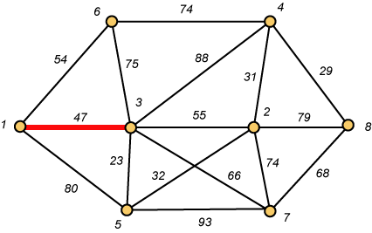
Prim – Step 1

Slide 45
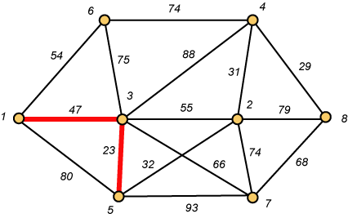
Prim – Step 2

Slide 46
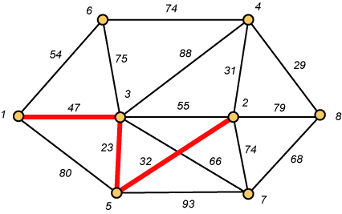
Prim – Step 3

Slide 47
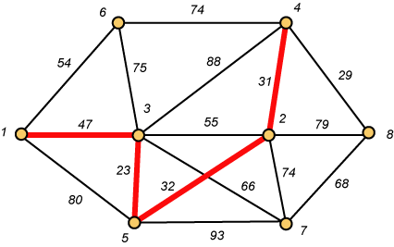
Prim – Step 4

Slide 48
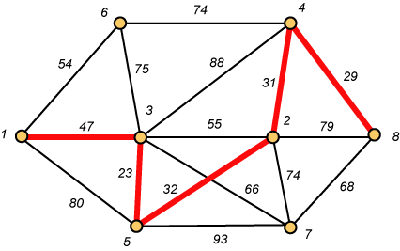
Prim – Step 5

Slide 49
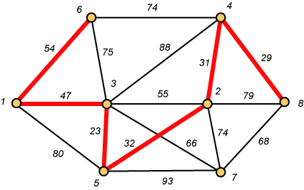
Prim – Step 6

Slide 50
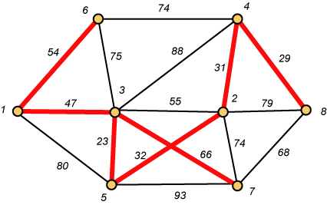
Prim – Step 7 Done!!
Weight (T) = 23 + 29 + 31 + 32 + 47 + 54 + 66 = 282

Slide 51
PRIM’S ALGORITHM
Initialize array
 | K | dv | Pv
A | F |  | ------
B | F |  | -------
C | F |  | ------
D | F |  | -------
E | F |  | ------
F | F |  | ------
G | F |  | ------
H | F |  | ------
2
F
3
10
C
7
A
4
3
4
18
8
B
4
D
9
10
H
2
25
E
3
G
7

Slide 52
PRIM’S ALGORITHM
Start with any node, say D
 | K | dv | Pv
A
B
C
D | T | 0 | --
E
F
G
H
2
3
F
10
C
7
A
4
3
8
18
B
D
4
9
10
H
2
25
E
3
G
7

Slide 53
PRIM’S ALGORITHM
Update distances of adjacent, unselected nodes
 | K | dv | Pv
A
B
C |  | 3 | D
D | T | 0 | --
E |  | 25 | D
F |  | 18 | D
G |  | 2 | D
H
2
3
F
10
C
7
A
4
3
18
8
B
D
4
9
10
H
2
25
E
3
G
7

Slide 54
PRIM’S ALGORITHM
Select node with minimum distance
 | K | dv | Pv
A
B
C |  | 3 | D
D | T | 0 | --
E |  | 25 | D
F |  | 18 | D
G | T | 2 | D
H
2
3
F
10
C
7
A
4
3
18
8
B
4
D
9
10
H
2
25
E
3
G
7

Slide 55
PRIM’S ALGORITHM
Update distances of adjacent, unselected nodes
 | K | dv | Pv
A
B
C |  | 3 | D
D | T | 0 | --
E |  | 7 | G
F |  | 18 | D
G | T | 2 | D
H |  | 3 | G
2
3
F
10
C
7
A
4
3
18
8
B
4
D
10
9
H
2
25
E
3
G
7

Slide 56
PRIM’S ALGORITHM
Select node with minimum distance
 | K | dv | Pv
A
B
C | T | 3 | D
D | T | 0 | --
E |  | 7 | G
F |  | 18 | D
G | T | 2 | D
H |  | 3 | G
2
3
F
10
C
7
A
4
3
18
8
B
4
D
10
9
H
2
25
E
3
G
7

Slide 57
PRIM’S ALGORITHM
Update distances of adjacent, unselected nodes
 | K | dv | Pv
A
B |  | 4 | C
C | T | 3 | D
D | T | 0 | --
E |  | 7 | G
F |  | 3 | C
G | T | 2 | D
H |  | 3 | G
2
3
F
10
C
7
A
4
3
18
8
B
4
D
9
10
H
2
25
E
3
G
7

Slide 58
PRIM’S ALGORITHM
Select node with minimum distance
 | K | dv | Pv
A
B |  | 4 | C
C | T | 3 | D
D | T | 0 | --
E |  | 7 | G
F | T | 3 | C
G | T | 2 | D
H |  | 3 | G
2
3
F
10
C
7
A
4
3
18
8
B
4
D
9
10
H
2
25
E
3
G
7

Slide 59
PRIM’S ALGORITHM
Update distances of adjacent, unselected nodes
 | K | dv | Pv
A |  | 10 | F
B |  | 4 | C
C | T | 3 | D
D | T | 0 | --
E |  | 2 | F
F | T | 3 | C
G | T | 2 | D
H |  | 3 | G
2
3
F
10
C
7
A
4
3
18
8
B
4
D
9
10
H
2
25
E
3
G
7

Slide 60
PRIM’S ALGORITHM
Select node with minimum distance
 | K | dv | Pv
A |  | 10 | F
B |  | 4 | C
C | T | 3 | D
D | T | 0 | --
E | T | 2 | F
F | T | 3 | C
G | T | 2 | D
H |  | 3 | G
2
3
F
10
C
7
A
4
3
18
8
B
4
D
9
10
H
2
25
E
3
G
7

Slide 61
PRIM’S ALGORITHM
Update distances of adjacent, unselected nodes
 | K | dv | Pv
A |  | 10 | F
B |  | 4 | C
C | T | 3 | D
D | T | 0 | --
E | T | 2 | F
F | T | 3 | C
G | T | 2 | D
H |  | 3 | G
2
3
F
10
C
7
A
4
3
18
8
B
4
D
9
10
H
2
25
E
3
G
7
Table entries unchanged

Slide 62
PRIM’S ALGORITHM
Select node with minimum distance
 | K | dv | Pv
A |  | 10 | F
B |  | 4 | C
C | T | 3 | D
D | T | 0 | --
E | T | 2 | F
F | T | 3 | C
G | T | 2 | D
H | T | 3 | G
2
3
F
10
C
7
A
4
3
18
8
B
4
D
9
10
H
2
25
E
3
G
7

Slide 63
PRIM’S ALGORITHM
Update distances of adjacent, unselected nodes
 | K | dv | Pv
A |  | 4 | H
B |  | 4 | C
C | T | 3 | D
D | T | 0 | --
E | T | 2 | F
F | T | 3 | C
G | T | 2 | D
H | T | 3 | G
2
3
F
10
C
7
A
4
3
18
8
B
4
D
9
10
H
2
25
E
3
G
7

Slide 64
PRIM’S ALGORITHM
Select node with minimum distance
 | K | dv | Pv
A | T | 4 | H
B |  | 4 | C
C | T | 3 | D
D | T | 0 | --
E | T | 2 | F
F | T | 3 | C
G | T | 2 | D
H | T | 3 | G
2
3
F
10
C
7
A
4
3
18
8
B
4
D
9
10
H
2
25
E
3
G
7

Slide 65
PRIM’S ALGORITHM
Update distances of adjacent, unselected nodes
 | K | dv | Pv
A | T | 4 | H
B |  | 4 | C
C | T | 3 | D
D | T | 0 | --
E | T | 2 | F
F | T | 3 | C
G | T | 2 | D
H | T | 3 | G
2
3
F
10
C
7
A
4
3
18
8
B
4
D
9
10
H
2
25
E
3
G
7
Table entries unchanged

Slide 66
PRIM’S ALGORITHM
Select node with minimum distance
 | K | dv | Pv
A | T | 4 | H
B | T | 4 | C
C | T | 3 | D
D | T | 0 | --
E | T | 2 | F
F | T | 3 | C
G | T | 2 | D
H | T | 3 | G
2
3
F
10
C
7
A
4
3
18
8
B
4
D
9
10
H
2
25
E
3
G
7

Slide 67
PRIM’S ALGORITHM
Cost of Minimum Spanning Tree =21
DONE
 | K | dv | Pv
A | T | 4 | H
B | T | 4 | C
C | T | 3 | D
D | T | 0 | --
E | T | 2 | F
F | T | 3 | C
G | T | 2 | D
H | T | 3 | G
2
3
F
C
A
4
3
B
4
D
H
2
E
3
G

Slide 68
Difference between Prim’s and Kruskal’s algorithm
Prims | Kruskal’s
Prim’s algorithm initializes with a node | Kruskal’s algorithm initiates with an edge
Prim’s algorithms span from one node to another | Kruskal’s algorithm select the edges in a way that the position of the edge is not based on the last step
In prim’s algorithm, graph must be a connected graph | Kruskal’s can function on disconnected graphs too.

Slide 69
Applications
Topology
Geometry
Clustering
Routing Algorithms
Generation of Mazes

